Slide 1
Lecture 17
Economic Growth, Information and Cities
17.1 Information and Economic Growth: Fortune’s formula and beyond
IUS 9.3
©Luís M. A. Bettencourt 2024
Notes:
We will now deal with the final part of these lectures (before summarizing, in the next lecture), with sources of innovation and economic growth and how they are facilitated by urban environments.

Slide 2
What creates growth?
$$η$$
structural
individual
groups
urbanization
learning, agency, investment, cooperation
?
more fundamental
Notes:
Having traced the effects of sorting into cities, in the last lecture, we now ask what creates fundamental changes in economic growth rates within cities. This is be about learning.

Slide 3

From an individual’s perspective:
Life Course
labor and capital; time and energy
What to “invest” effort in?
uncertainty & risk
short-time vs long-term decisions
peer group and ‘culture’, innovation
life events
Changes when people come to cities
time
agency
+
“environment”
Changes through the life course
cumulative (dis)advantage
intervention points
knowledge and productivity
bad luck and vicious cycles
remember: your life path [world line]
how to invest time and effort, resources?
outcomes
Notes:
The theory of these processes is still being worked out in detail. It is a monumental task, that will change the social sciences and complex systems. But the main ingredients are clear enough ad illustrated by this picture. Individuals live in complex environments and make decisions over their life courses. These are subjected to inheritance of both resources and information, uncertainty, learning and always incomplete information. Remember how the life path was a building block of urban scaling theory? Now we are taking this idea as a learning path over the life course. Urban environments require change and adaptation, and can promote growth via the processes undergone by each individual and organization.

Slide 4
Prediction
“Knowledge”
There is a deep and beautiful relationship between
Resources
“Wealth”
In finance, economics
This is common across all complex systems. Unifies evolution, (machine) learning theory, financial mathematics.

Slide 5
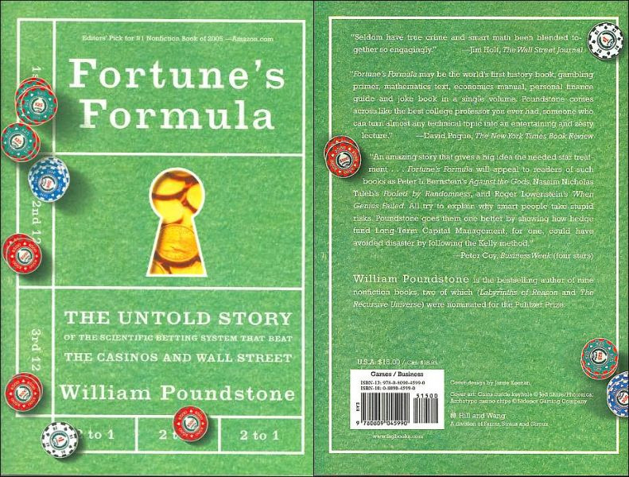
There is an optimal way to approach this problem…
http://www.fortunesformula.com
Notes:
The foundational ideas were developed in statistics and information theory…

Slide 6
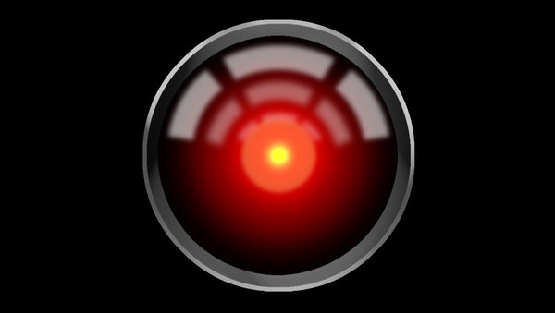
Notes:
Do you know what this is? You sci-fi buffs?

Slide 7
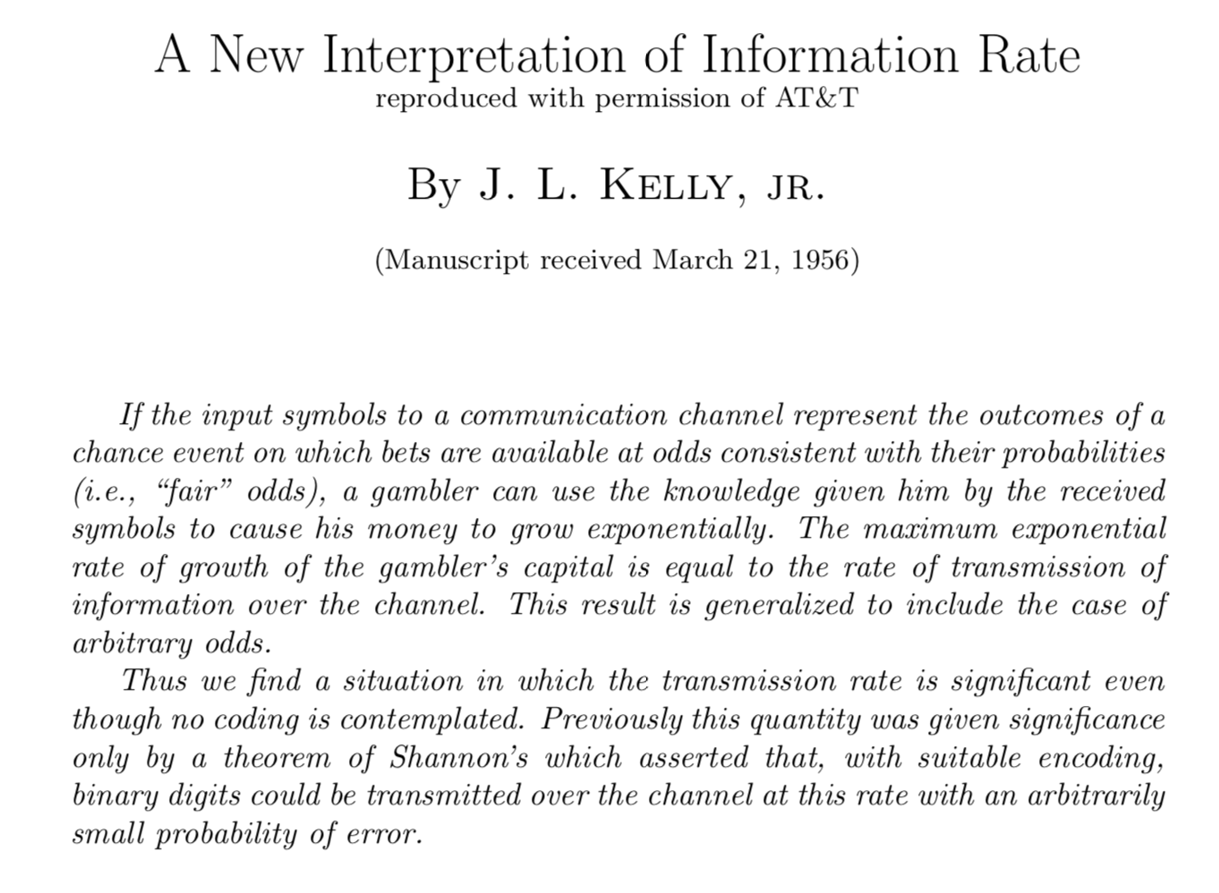
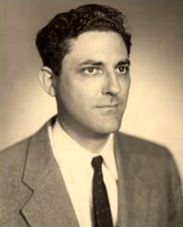
betting on horse races
with math!
https://www.princeton.edu/~wbialek/rome/refs/kelly_56.pdf
Notes:
Well the man who co-invented Hal 2000, also wrote an important paper on how information is the growth rate for the growth of wealth in uncertain but knowable environments.

Slide 8
An illustration:
Simplest case: binary choice
heads/tails, red/black, 0/1 etc
Consider a series of events:
$$e_{1},e_{2},…,e_{i},…∈E$$
Environment
Payoff of guessing right:
$$o(e_{i})≥1.$$
Your knowledge:
(intuition, friend, experience):
$$s_{1},s_{2},…,s_{i},…∈S$$
0 0 1 1 0 0 1 1 0 1
Given your knowledge, allocate:
$$\underset{e}{∑}f(e|s)=1$$
$$f(e|s)r$$
fraction of your “wealth”
At each step the environment returns state
$$e_{i}$$
Your resources (wealth) grow like:
$$r→r^{′}=o(e_{i})f(e_{i}|s_{j})r$$
proportional to $r$
Notes:
Here is how it works: Just as in a game, it is assumed that there are opportunities in life and that if agents make the right investments (commitments of wealth, energy and effort) these can grow cumulatively. The idea is to ask what is the optimal allocation of resources to possibilities in the environment, when we make long term investments. (For one-shot investments, we get standard decision theory but that is pathological over the long term).

Slide 9
After n steps:
$$r(n)=Π_{j=1}^{n}o(e^{j})f(e^{j})r$$
product: choices compound (multiplicatively)
The average growth rate is then
$$v=n/T$$
velocity of investments
$$η=\lim_{n→∞}\frac{v}{n}ln\frac{r(n)}{r}=v\overset{E}{\underset{i=1}{∑}}P(e_{i})lno(e_{i})f(e_{i}).$$
$$ν=\frac{n}{t}$$
probability of $e_{i}$
speed of investments
What is the best allocation?
maximizes growth rate, subject to normalization
$$F[f]=η[f]+λ(\underset{e_{i}}{∑}f(e_{i})-1)$$
$$f(e_{i})=P(e_{i})$$
“proportional betting”
$$\frac{dF}{df}=0→\frac{P(e_{i})}{f(e_{i})}-λ=0→f(e_{i})=\frac{P(e_{i})}{λ}.$$
$$lno=\overset{E}{\underset{i=1}{∑}}P(e_{i})lno(e_{i})$$
$$η=v(lno-H(E))$$
odds must be good enough more complex environments are costly
Notes:
Over the long term (inter temporal optimization) winning bets multiply. The growth rate is then the log of these returns and - by the law of large numbers - converges to its mean under quite general conditions. The optimal allocation of resources can be calculated, and is proportional to the probability of events in the environment.

Slide 10
What happens when resources are conserved across the population (equilibrium)?
Total money bet = Total money paid
Bookie
Total sales = Total purchases (demand)
Market
We can then calculate the odds (or prices):
Consider a population of agents $j$=1,…,N
Each invests their resources $r_{j}$, using an allocation $f_{j}(e_{i})$
Total bet:
$$N\overline{r}=\underset{i,j}{∑}f_{j}(e_{i})r_{j}$$
$$o(e_{i})=\frac{N\overline{r}}{∑_{j}f_{j}(e_{i})r_{j}}→\frac{1}{P(e_{i})}.$$
Total paid:
$$\underset{j}{∑}f_{j}(e_{i})o(e_{i})r_{j}=o(e_{i})\underset{j}{∑}f_{j}(e_{i})r_{j}$$
?
Note that:
$$\underset{j}{∑}f_{j}(e_{i})r_{j}=\underset{j}{∑}P(e_{i}|j)P(j)r_{j}=N\overline{r}P(e_{i})+N\overline{r}covar(f_{j}(e_{i}),\frac{r_{j}}{N\overline{r}})$$

Slide 11
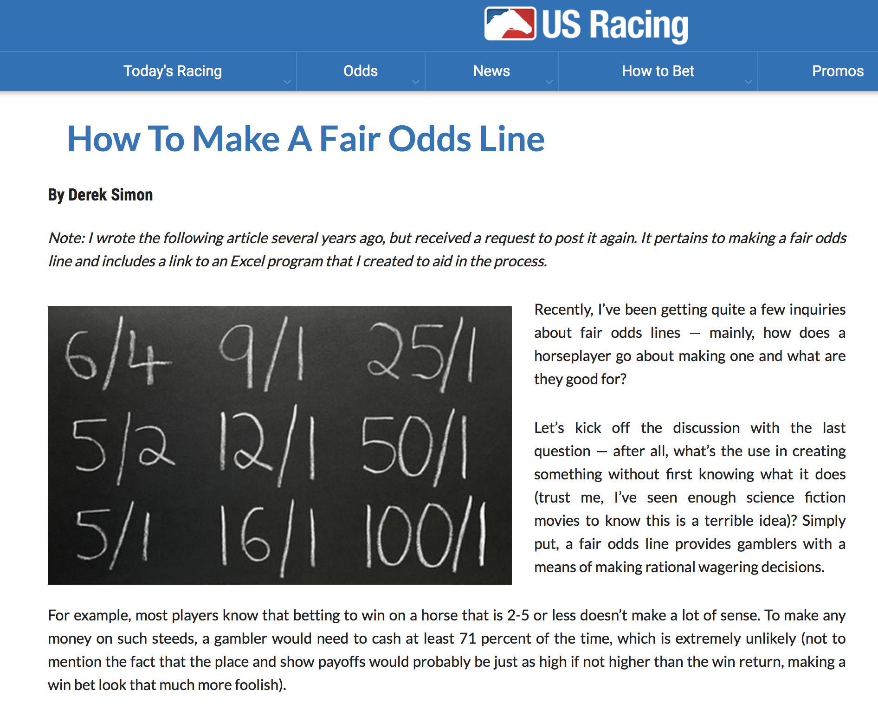
https://www.usracing.com/news/horse-betting-101/making-a-fair-odds-line
https://www.usracing.com/news/horse-betting-101/making-fair-odds-line
Notes:
Fair odds just means that the payoffs are proportional to the population expectation of the outcome, and mean that no-one makes money on average. This is not always true in life, there are free lunches in nature such as sunlight, leading to energy sources into human economies.

Slide 12
Fair odds:
$$lno=\overset{E}{\underset{i=1}{∑}}P(e_{i})lno(e_{i})→H(E)$$
$$o(e_{i})=1/P(e_{i})$$
Also average “belief”
For fair odds, the growth rate vanishes:
$$η=v(lno-H(E))→0.$$
Because all agents are doing the same optimal thing, and resources are fixed
This reflects a situation when the agent does not have inside information
Need “better” knowledge to beat odds or “market” (average belief)
This is the basic argument for economic markets; not (fully) planned economies
Hayek 1945
https://www.jstor.org/stable/1809376
Notes:
But this is not enough. It leads to zero growth, when there are perfect odds, which means that it is a zero sum market.

Slide 13
First, let’s generalize the simplest situation:
$$o(e_{i})=1/P_{m}(e_{i})$$
guess (estimation) from market, or “crowd”, or bookie
Imperfect estimate
(simplify: $v=1$)
$$η=\overset{E}{\underset{i=1}{∑}}P(e_{i})ln\frac{f(e_{i})}{P(e_{i})}\frac{P(e_{i})}{P_{m}(e_{i})}=D_{KL}(P||P_{m})-D_{KL}(P||f)$$
A better predictor than average grows !
can benefit from imperfect “markets” if we know the actual probability (better)
But what if we had special private information (edge)?
$$η=\underset{i,j}{∑}P(e_{i},s_{j})lno(e_{i})f(e_{i}|s_{j})$$
“signal” = memory, knowledge, private channel
Notes:
When odds are not fair, the growth rate is lower, by a factor of a KL divergence, as shown here.
The most interesting situation is when each individual has special information, whether this is a trait, their now life experience, learning etc…

Slide 14

For optimal wealth generation:
Maximize
$$η=\underset{i,j}{∑}P(e_{i},s_{j})lno(e_{i})f(e_{i}|s_{j})$$
to get the best allocation
$$f(e_{i}|s_{j})$$
$$f(e_{i}|s_{j})=\frac{P(e_{i},s_{j})}{P(s_{j})}=P(e_{i}|s_{j})$$
This leads to
Fortune’s Formula !!
conditional probability of specific event given private signal
$$Δη=\underset{i,j}{∑}P(e_{i},s_{j})ln\frac{P(e_{i},s_{j})}{P(e_{i})P(s_{j})}=i(E,S)$$
Mutual Information !!
between environment and private signal
improvement in rate from using the private signal
“knowledge pays”
https://www.sciencedirect.com/science/article/pii/S1631070519300350
Notes:
In this case, one obtains different investment scheme, set by the conditional distribution of events given these signals. The growth rate then is the mutual information between the agents signals and the states of the environment.

Slide 15
resources will grow exponentially!!
with a rate given by the information of the signal on the environment
$$Δη=i(E,S)-D[P(e|s)||f(e|s)]$$
Either information is given (“friend”)
> 0, if estimate is imperfect
Or it must be learned:
$$f(e|s^{n+1})=\frac{p(e|s)}{p(e)}f(e|s^{n})$$
Bayesian learning by observation/experience is Optimal
$$D[P(e|s)||f(e|s^{n})]∼1/n$$
but learning from experience is VERY slow
No one learns what they know primality from experience, they learn most of it from others.
Notes:
Again, when the optimal conditional distribution is not used, the agent plays a penalty in terms of growth. It turns out that Bayesian learning is optimal as a way to incorporate causal information as the agent experiences it. But this is slow and hard earned.

Slide 16
But observed growth rates are much smaller than in a game!
at the “frontier”
The meaning of an annual 2% growth rate:
1% = doubling (of capital) every 72 years
“rule of 72”
2% per year=doubling every 36 years
~ human generation
why so “slow”?
it takes a lifetime to create new productive information
opportunities that can be learned, education, training, predictability all matter a lot
Notes:
The observed growth rates suggest - along with a lot of other evidence about development - that the human life course is the relevant scale of change in societies, including for economic growth.

Slide 17
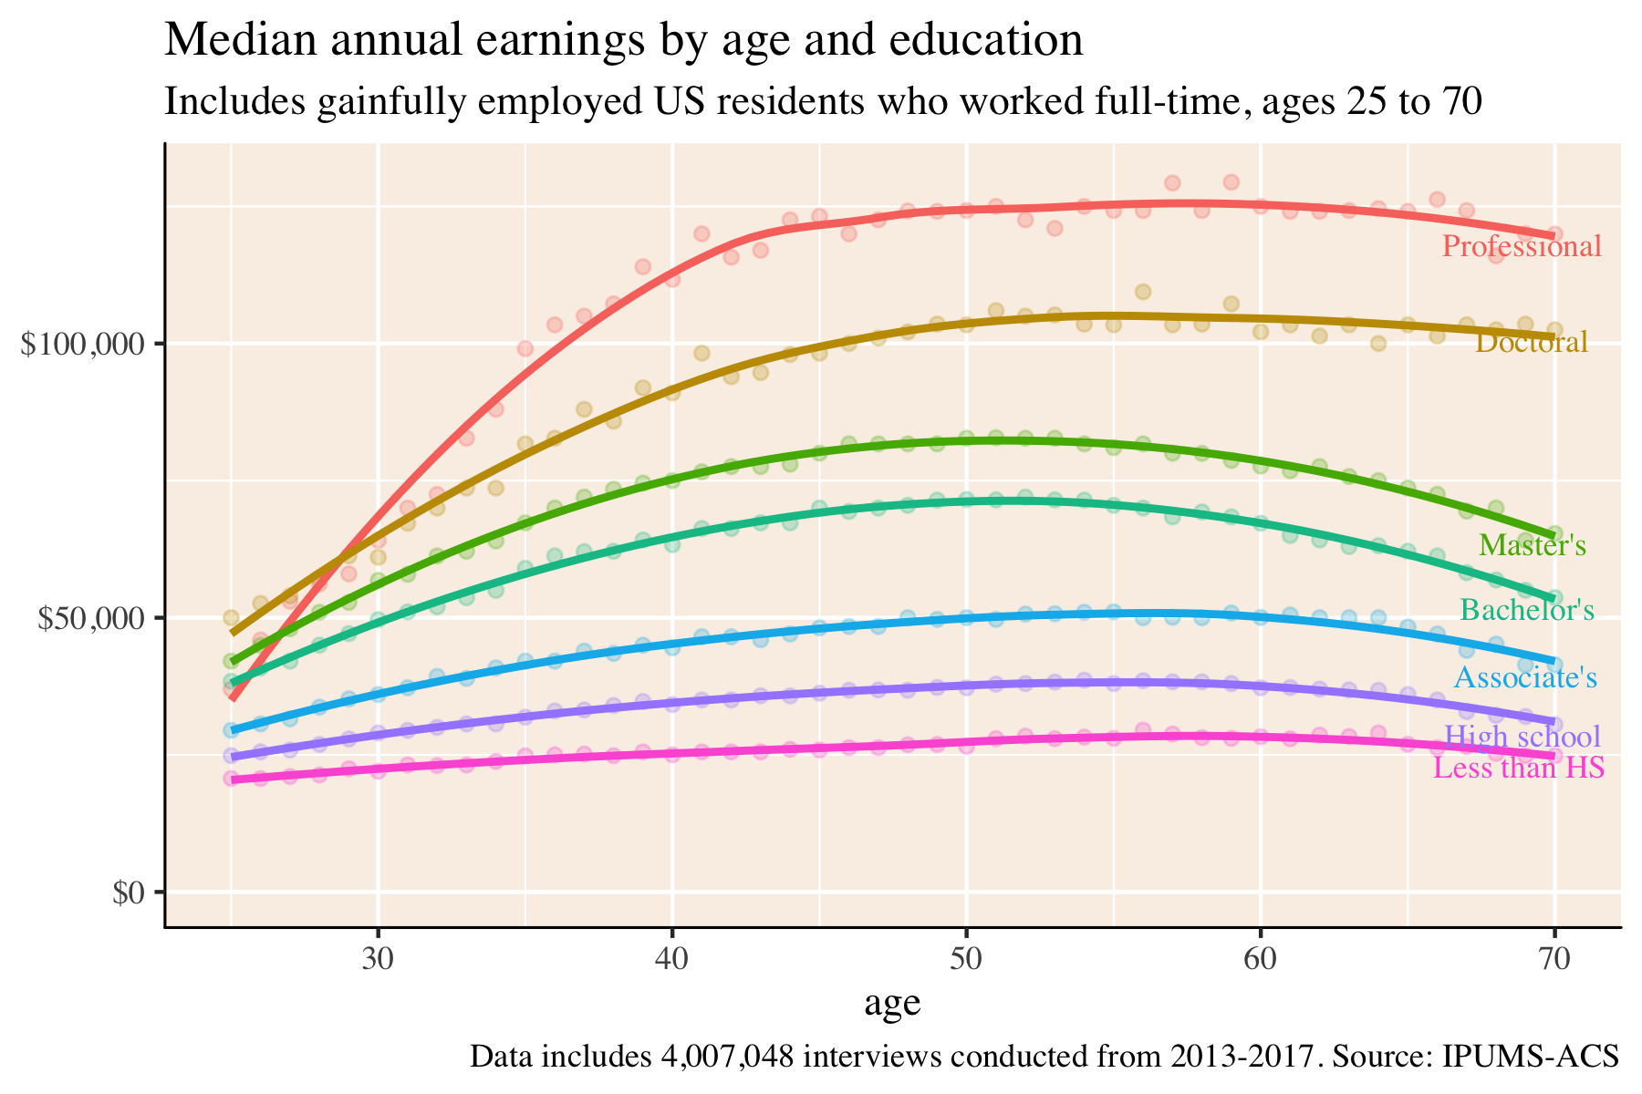
Also become more specialized
25
Learners make no income till later
Importance of life course + learning environments
https://johndjohnson.info/post/some-graphs-about-wages/

Slide 18
Making new (complex) things is very difficult for individuals as it requires integrating a lot of knowledge
Markets/bets/search engines only integrate information to a point : averaged between individuals
Additional assembly mechanisms are necessary
Firms, organizations, cities

Slide 19
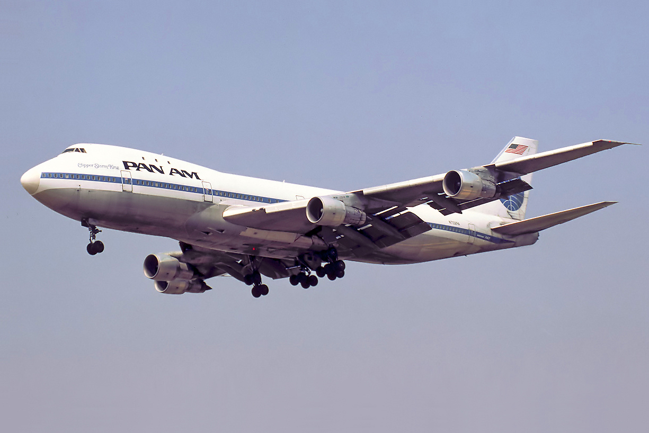
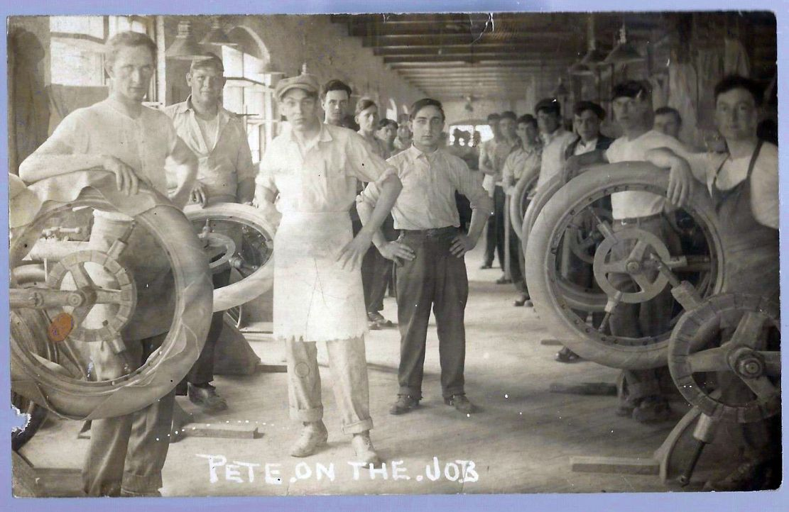
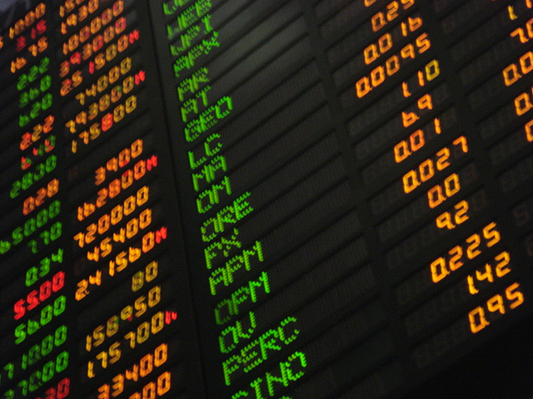
Integration over time has a parallel in integration in socioeconomic networks (over space)
But whose knowledge (in the production of complex things)?
Whose Resources?
Notes:
One last argument, for cities, is how individual knowledge is produced and combined to create complex things that had added value. All these require concentrated social interactions, in firms, but also in cities.

Slide 20
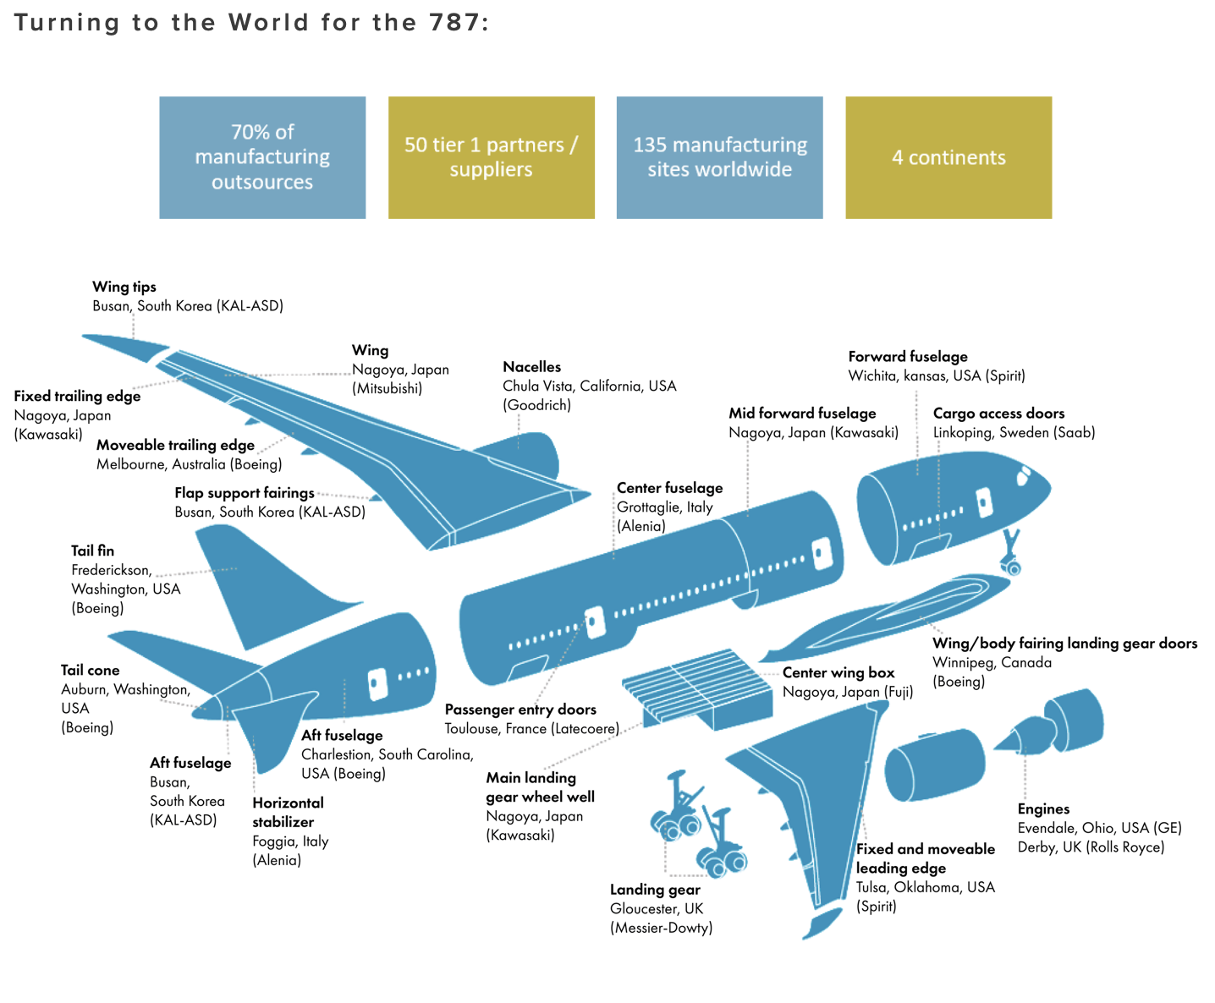
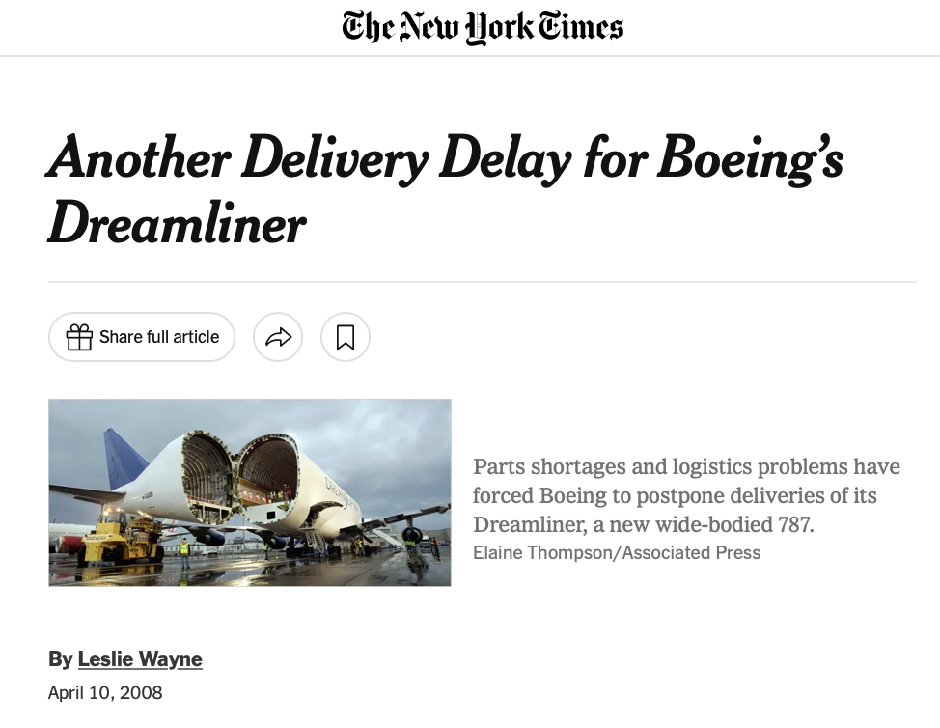
Making the Boeing 787 (“Dreamliner”)
https://www.nytimes.com/2008/04/10/business/10boeing.html
https://www.whitehorncapital.com/whitehorn-blog/outsourcing-the-dreamliner

Slide 21
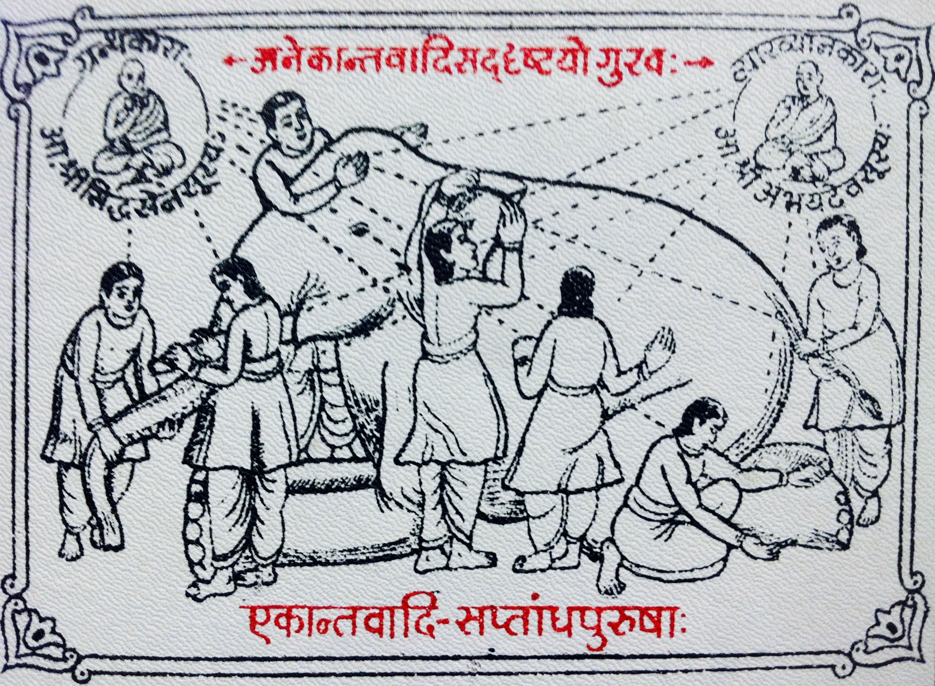
Organizations have synergistic information
information in the organization is more than sum of the parts!
$$I(\{Y\};X)>\underset{j}{∑}I(Y_{j},X)$$
Blind men and the elephant. credit: wikipedia
how should earned resources be distributed among agents?
Team Production Problem
Division of knowledge and Labor:
and putting it back together fairly, so that it can be repeated and elaborated
https://onlinelibrary.wiley.com/doi/10.1111/j.1756-8765.2009.01047.x
Notes:
Information has this property too, the combination of information that is complementary (different) at predicting outcomes leads to aggregate information that is more than the sum of the parts. A simple metaphor is the parable of the blind men and the elephant.
In a diverse society where interactions are possible, this selective pooling of information becomes a great source of growth, and takes the form of all the complex organizations around us.

Slide 22
Firms and Organizations
synergy and redundancy
1) Organizations have synergistic information
coordination of people’s behavior towards a common goal = new information structures for task
2) Information can also be redundant
two people can know the same thing
3) Diversity of Information (maximal synergy) is necessary for growth:
maximum information requires “maximum synergy”=maximum “diversity” !
not for efficiency! not even for justice: For fastest collective growth and knowledge
Notes:
This is often called synergy (though the word also takes some more popular meanings). Maximum synergy is necessary for faster growth, and introduces a new optimization principle in socioeconomic structures.

Slide 23
Consequences:
- knowledge always wins over initial capital*
- knowledge has an enormous value, for others and into the future
positive externalities, spillovers
- knowledge producers are not able to capture its full value
public investment is necessary, “public goods problem”
- knowledge can attract capital (for a rent)
entrepreneurship, start-ups, grants, finance, loans
- *but capital can also buy knowledge (licensing, hiring)
patents
environments that promote collective knowledge, learning and “assembly” are key for growth:
Cities !!
In such environments you will see: diversity, interdependence, connectivity, conflict control, learning, turnover, public institutions
resulting in experimentation, innovation and fast change.
Notes:
have now come full circle, to understand the role of knowledge in (economic) growth, and the conditions that allow a society to have it and to use it. This is, in a profound sense, what cities are and what they are for. Cities that neglect these aspects of their nature are likely to enter decay (they will fail to reinvent themselves), while those who do will grow faster, become more diverse and complex, and define what urbanism, and developed societies, will be in the future.

